Slide 1
Monitoring for AWS
SYS-360

Slide 2
Monitoring in AWS EC2
Monitoring is an important part of maintaining the reliability, availability, and performance of your Amazon EC2 instances and your AWS solutions.
You should collect monitoring data from all of the parts in your AWS solutions so that you can more easily debug a multi-point failure if one occurs.
Also critical in detecting security events

Slide 3
Monitoring Goals
Before you start monitoring Amazon EC2, however, you should create a monitoring plan that should include:
What are your goals for monitoring?
What resources will you monitor?
How often will you monitor these resources?
What monitoring tools will you use?
Who will perform the monitoring tasks?
Who should be notified when something goes wrong?

Slide 4
Monitoring EC2 - Establishing a Baseline
To establish a baseline for normal Amazon EC2 performance in your environment.
measure Amazon EC2 performance at various times and under different load conditions.
store a history of monitoring data that you've collected
compare current Amazon EC2 performance to this historical data to help you to identify
normal performance patterns
performance anomalies
Optimization methods

Slide 5
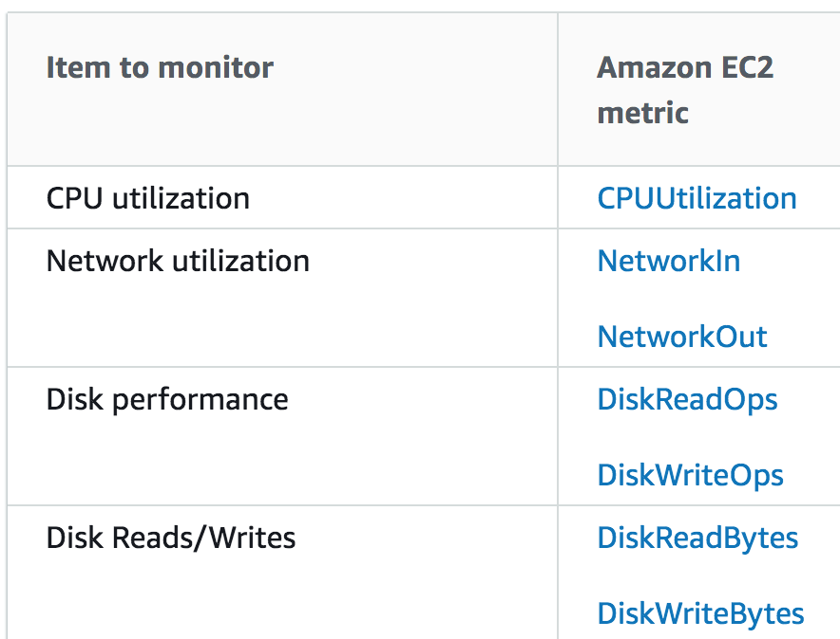
Minimum Baseline
EC2 will log the following metrics by default which can help set a minimum baseline
Additional Metrics such as
Memory utilization
Disk space utilization
Page file/swaps
Require an agent on the instance

Slide 6
Automated Monitoring in AWS
Systems Status Checks:
Monitors the AWS Systems required to support an Instance
Instance Status Checks:
Monitor the software and network configurations of individual instances
CloudWatch Events and Alarms:
Use the Amazon CloudWatch service to identify issues that can arise over time

Slide 7
AWS System Status Checks
Monitor the AWS systems required to use your instance to ensure that they are working properly.
These checks detect problems with your instance that require AWS involvement to repair.
When a system status check fails, you can choose to wait for AWS to fix the issue or you can resolve it yourself (for example, by stopping and restarting or terminating and replacing an instance).
Examples of problems that cause system status checks to fail include:
Loss of network connectivity
Loss of system power
Software issues on the physical host
Hardware issues on the physical host that impact network reachability

Slide 8
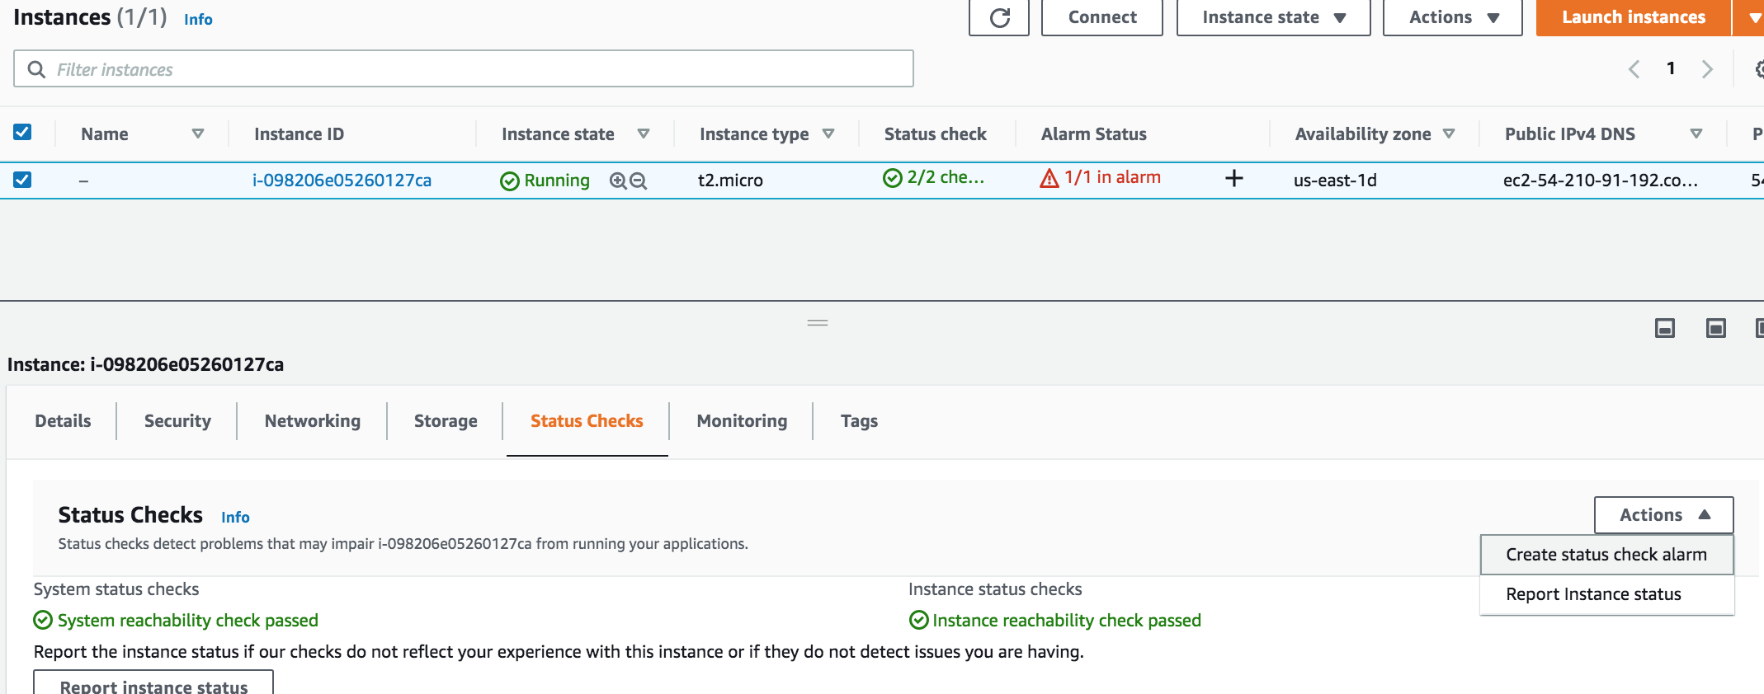
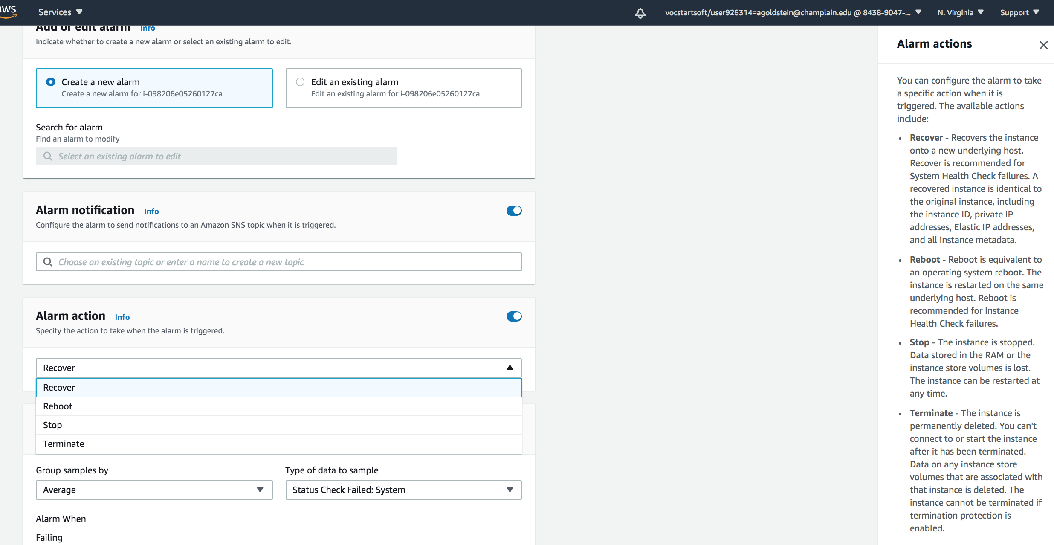
AWS System Status Checks

Slide 9
AWS Instance Status Checks
Monitor the software and network configuration of your individual instance.
These checks detect problems that require your involvement to repair.
Examples of problems that may cause instance status checks to fail include:
Misconfigured networking or startup configuration
Exhausted memory
Corrupted file system
Incompatible kernel

Slide 10
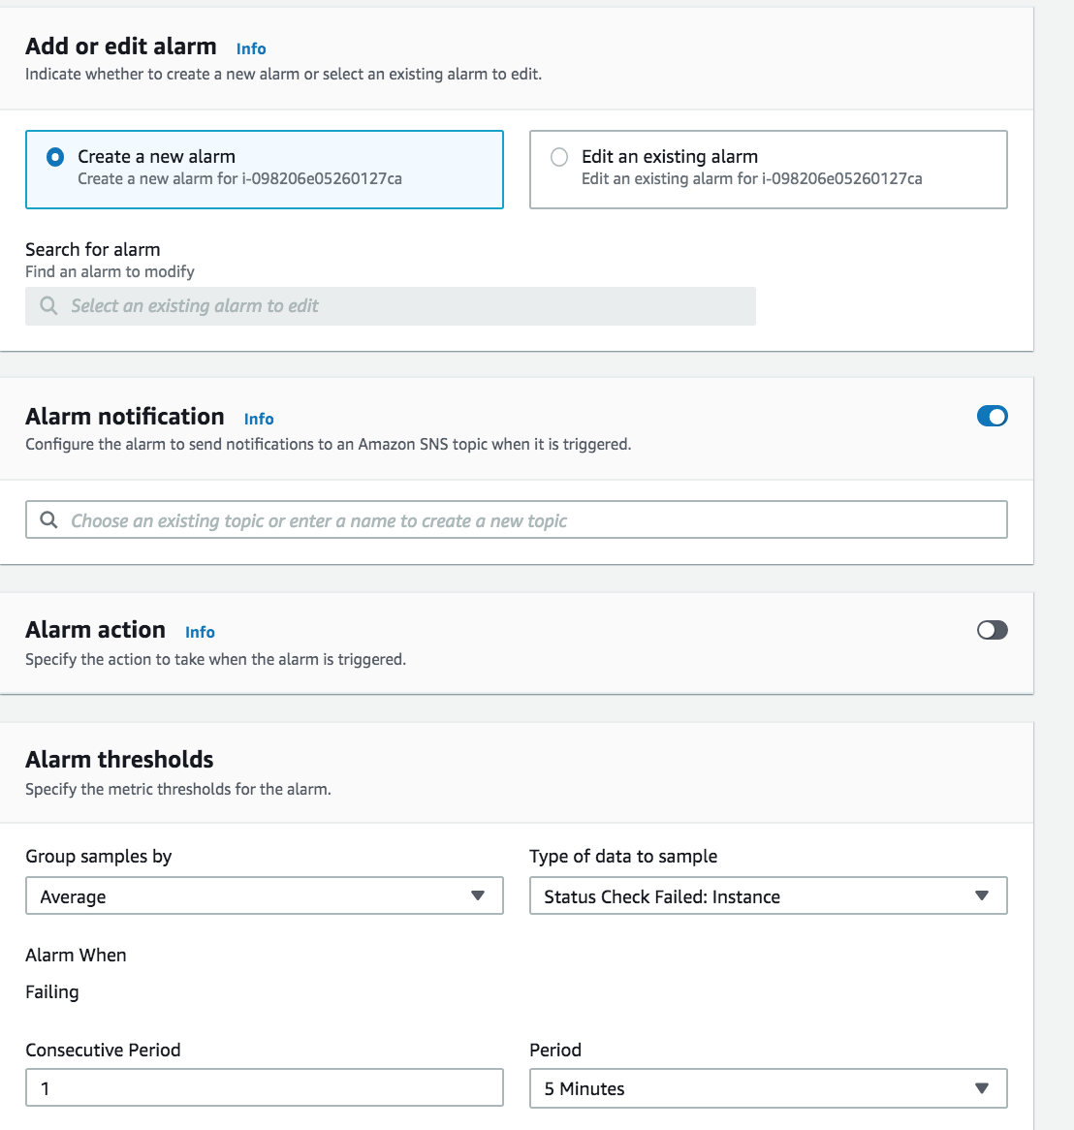
AWS Instance Status Check Alarm

Slide 11
AWS CloudWatch
This is the topic for your homework and lab this week!
Amazon CloudWatch collects and processes raw data from Amazon EC2 into readable, near real-time metrics.
It is a separate AWS Service (it has its own console!)

Slide 12
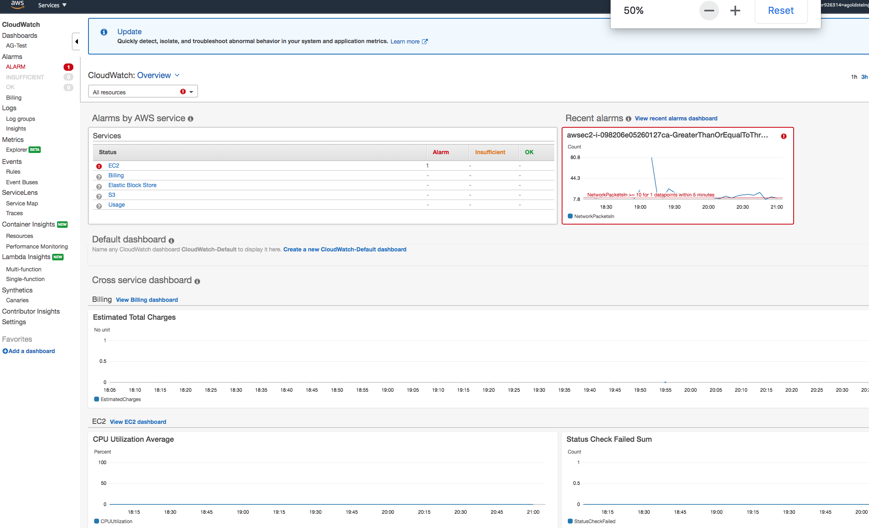
CloudWatch Console

Slide 13
AWS CloudWatch
Basic Monitoring: By default, Amazon EC2 sends metric data to CloudWatch in 5-minute periods. This is Free (no $)
Detailed Monitoring: Sends data (metrics) for your instance to CloudWatch in 1-minute periods,
Can be enabled per instance
Can cost $ if exceed free-tier usage
Alarms: Can create alarms if certain conditions are observed.
Can simply notify through console or e-mail - and/or
Take an action such as reboot, shutdown, or terminate an instance

